Slide 1
Medicaid School Based Programs
Conduent
Government Healthcare Solutions

Slide 2
Purpose
This training will provide an overview of the New Mexico Medicaid School Based Program. The training will familiarize providers with claim submittal information as well as instructions.

Slide 3
Objectives
We will review the following processes as they pertain to the Medicaid School Based Programs:
Overview of NM Medicaid Web Portal
Timely Filing Guidelines
Medicaid Primary Claim Instructions
School Based Claims Reminders

Slide 4
NM Medicaid Web Portal Overview
Conduent
Government Healthcare Solutions

Slide 5
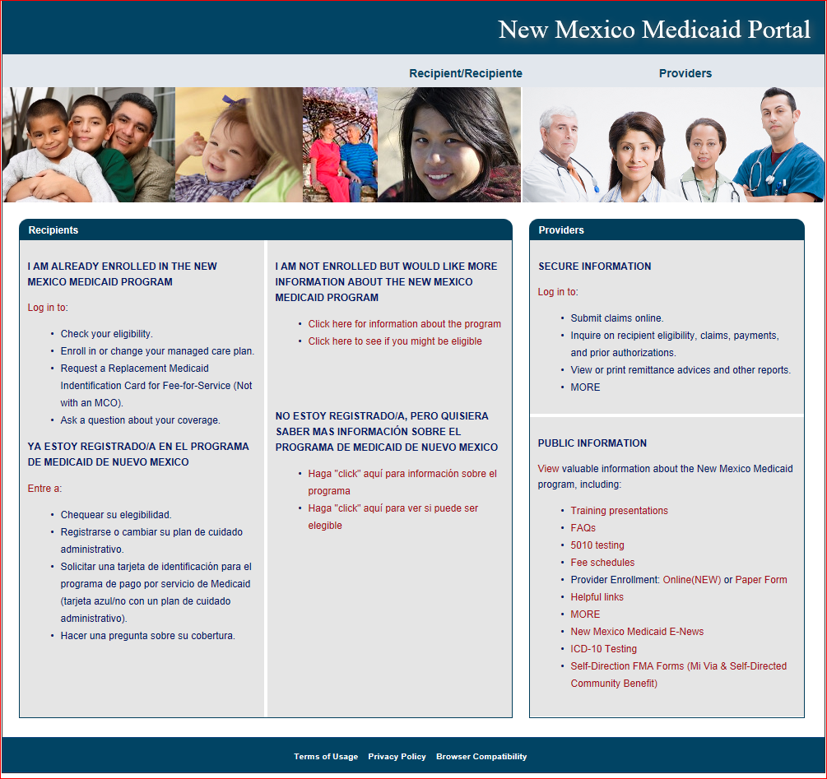
New Mexico Medicaid Portal

Slide 6
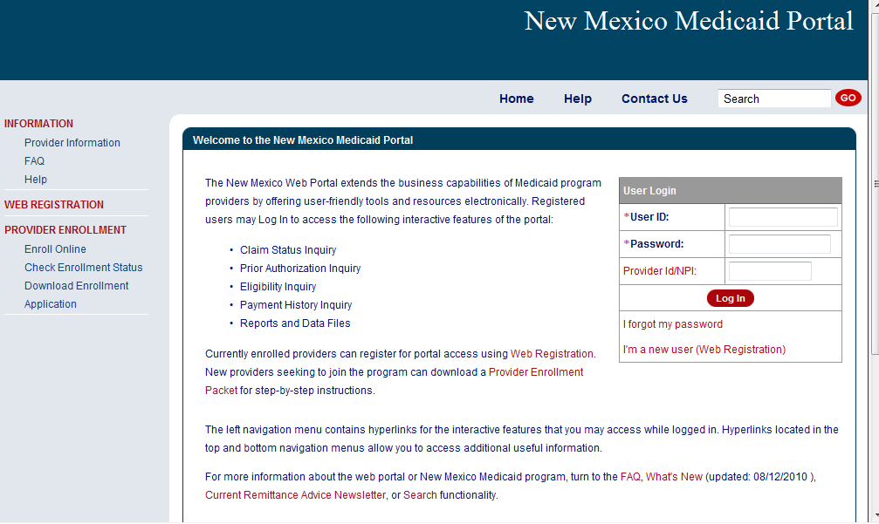
New Mexico Medicaid Portal
Non Secure Features
Secure Features requires login

Slide 7
New Mexico Medicaid Portal
Click “I’m a new user” to begin web registration

Slide 8
Web Registration
Large Organizations with Multiple Billing Provider Numbers
Organizations with multiple billing provider numbers have to register each billing provider number in the web portal in order to inquire on claims, Prior Authorizations (PA) and payment history, as well as to access Remittance Advices (RA) and PAs used unit reports for each of their billing provider numbers.

Slide 9
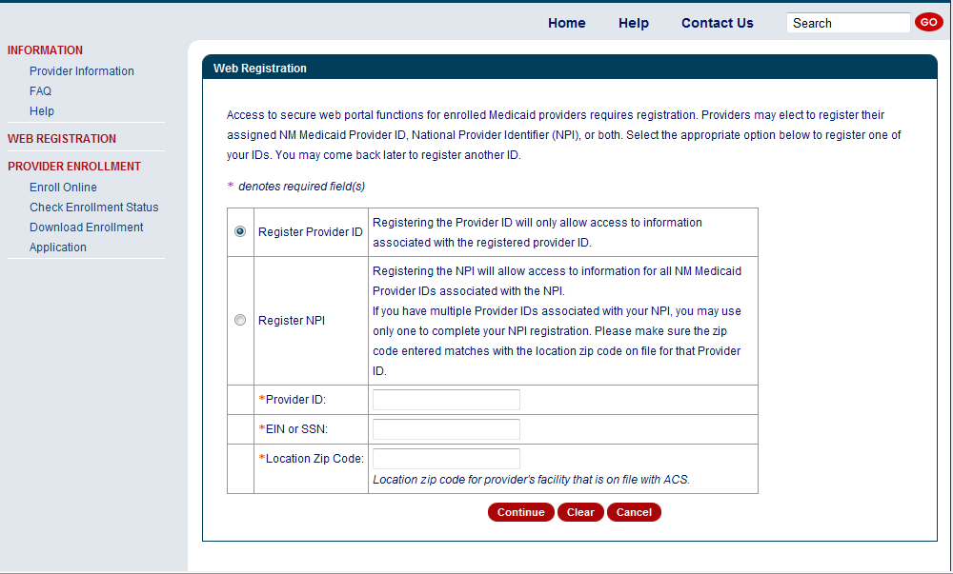
Web Registration – How to Log-in
Complete every field that contains an asterisk

Slide 10
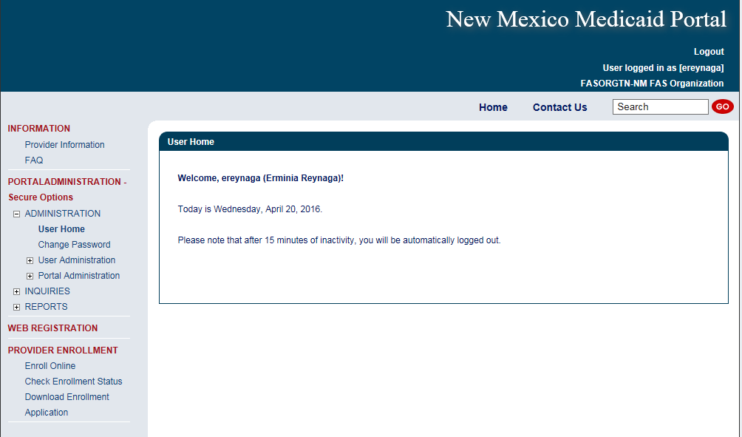
User Privileges
All authorized privileges for the user will be listed in the blue left hand side navigation bar

Slide 11
Eligibility Inquiry
The system will default the current date for date of service.
You can use any DOS within the past 2 years.
Date spans can be used.
Recipients can be searched using the following options:
Recipient ID (this is the “SSN” style ID number, Medicaid ID, temporary SSN etc. 942XXXXXX)
SSN and date of birth OR….
Last name, first name, date of birth (information needs to match what is on the Omnicaid system)
Notes:
What does GSA stand for?

Slide 12
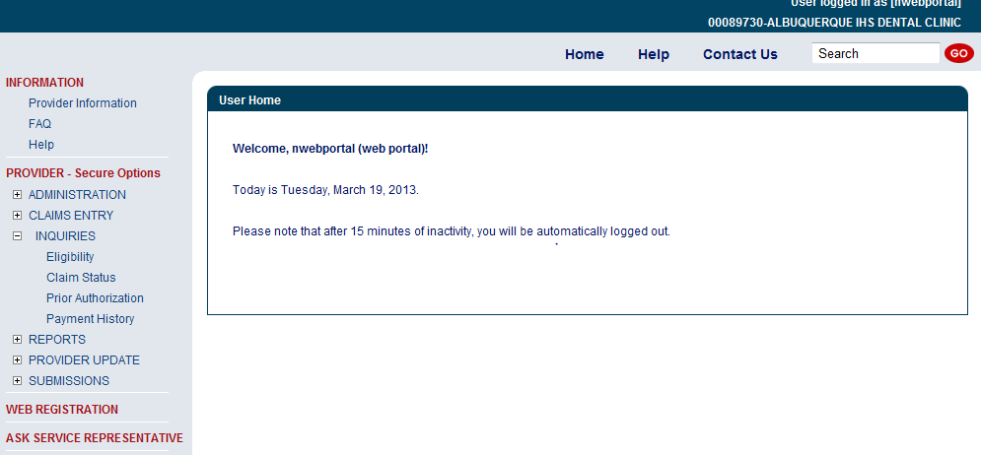
Eligibility Inquiry
Expand Inquiries by clicking on the (+) sign then click on “Eligibility”
Notes:
What does PEDS stand for?

Slide 13
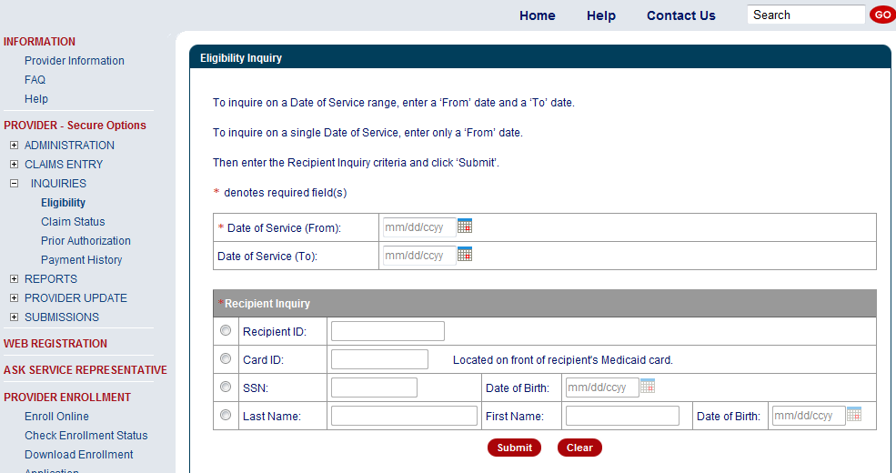
Eligibility Inquiry
The “SSN-style” ID number
Notes:
What does PEDS stand for?

Slide 14
Eligibility Inquiry
If the recipient is eligible on the date entered, the response will include:
Category of Eligibility (COE) and description
All lock-ins
Medicare information
Third Party Liability (TPL) information
Long Term Care information, if there is a long term care span (abstract) on file for the date entered that matches the inquiring provider number.
Notes:
What does GSA stand for?

Slide 15
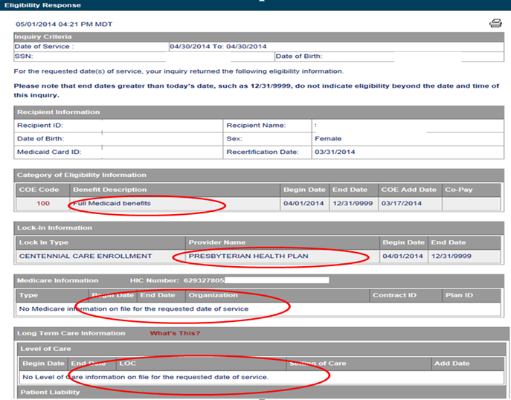
Eligibility Inquiry Continued
COE add date is important for timely filing purposes
This person is receiving COE 100
Notes:
What does PEDS stand for?

Slide 16
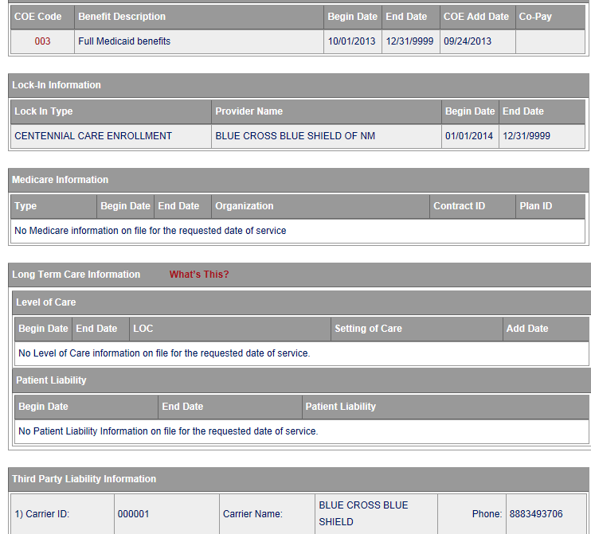
Eligibility Inquiry Continued
This person is blind receiving SSI COE 003
Please note: This person has both Managed Care and TPL.
Notes:
What does PEDS stand for?

Slide 17
Turquoise Care Managed Care Organizations (MCOs)
Reminder: Claims for recipients who are enrolled in Turquoise Care are submitted directly to the Managed Care Organization they are enrolled with. Following is the contact information for those MCOs.
Turquoise Care MCOs | Contact Number | Website
BlueCross BlueShield of New Mexico | (866) 689-1523 | www.bcbsnm.com/turquoise-care
Molina Healthcare | (844) 862-4543 | https://www.molinahealthcare.com/members/nm/en-US/pages/home.aspx
Presbyterian | (888) 977-2333 | http://www.phs.org/health-plans/turquoise-care-medicaid
United Healthcare Community Plan of NM | (877) 236-0826 | https://www.uhc.com/communityplan/new-mexico/plans

Slide 18
What is a Transaction Control Number (TCN)?
91704900085000001
The twelfth digit in an adjustment/ void TCN will either be:
1= Debit
2= Credit
The first digit indicates what the claim “media” is:
2 = electronic crossover
3 = other electronic claim
4 = system generated claim or adjustment
8 = paper claim
9 = Web portal claim entry
Batch number
The last two digits of the year the claim was received
The numeric day of the year.
The claim number within the batch.
This is the Julian Date - this represents the date the claim was received by Conduent: this claim was received the 49th day of 2017, or February 18, 2017
Notes:
Global slide – indicate somehow

Slide 19
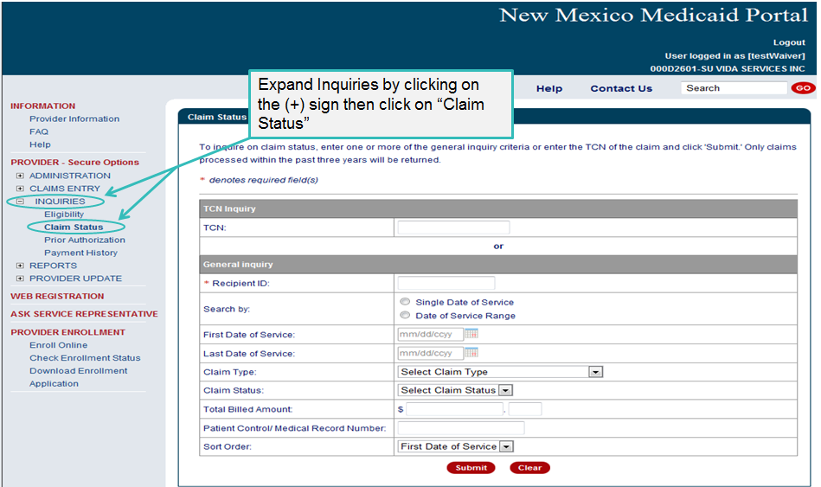
Claim Status Inquiry

Slide 20
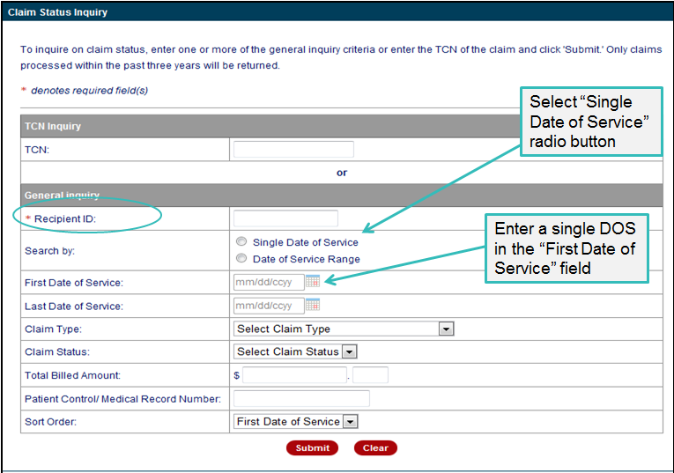
Single DOS Inquiry

Slide 21
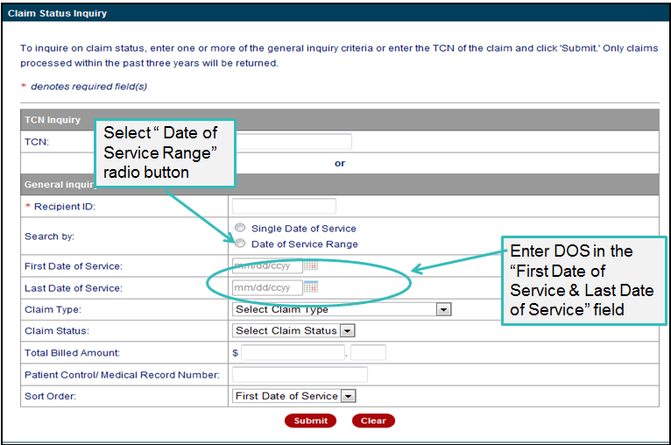
Date Range Inquiry

Slide 22
More on Claim Inquiry
Keep the following in mind as you use claim inquiry:
You will only see claim status (paid or denied) for the provider number you are logged in under, or have selected if you are logged in with an NPI.
If your search yields more than 200 results, you will only see the first 200 and a message will appear telling you that has happened. Narrow your criteria if this happens.

Slide 23
Types of Inquiries Reports and Data Files
Conduent
Government Healthcare Solutions

Slide 24
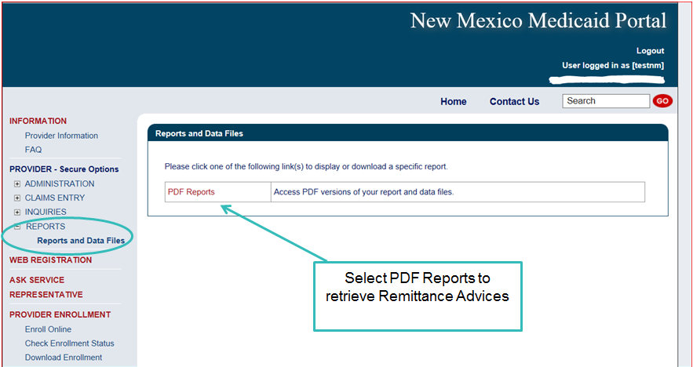
Reports and Data Files
Providers can obtain access to the last 8 RA’s from the Web Portal

Slide 25
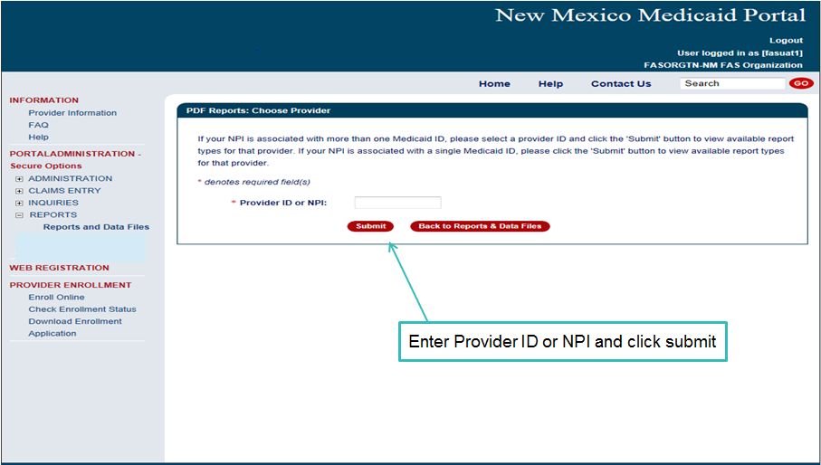
Reports and Data Files

Slide 26
Timely Filing Guidelines
Conduent
Government Healthcare Solutions

Slide 27
Timely Filing
All Fee For Service claims within 120 days from the initial date of service that do not require an attachment for payment must be submitted electronically.
For any assistance regarding Electronic Claims Submissions, contact the HIPAA Helpdesk
Via Email: HIPAA.Desk.NM@conduent.com
Via Phone: (800) 299-7304

Slide 28
Timely Filing
For schools, the filing limits are 120 days for the initial filing period and 120 days for the grace period (rather than 90 days).
When the recipient has retroactive eligibility, the initial filing limit is 120 days from the date the eligibility was added to the Conduent eligibility file and was therefore available to providers.

Slide 29
Exceptions to Timely Filing
When the provider was not originally enrolled as a MAD provider on the date of service, the filing limit of 90-days is counted from the date the provider was notified of the enrollment, but must not exceed 210 days from the date of service.
A provider should submit a provider participation agreement in sufficient time to allow processing and still meet the Medicaid 210 day limit for submitting the claim.

Slide 30
Timely Filing Hints
There are two filing limits to meet:
The initial filing limit – 120 days from date of service
The grace period limit – 90 days from paid/denial date
Continuing to re-file a claim does not continue to extend the filing limit. It is to the provider’s advantage to file or request an adjustment on the most recently filed claim that met the original filing limit.
When requesting an adjustment on an adjusted claim, use the TCN of the final payment or denial, not the credit record which has a negative amount on the RA.
The filing limit does not apply when the provider is returning an overpayment to the Medicaid program.

Slide 31
School Based Claims Reminders
Conduent
Government Healthcare Solutions

Slide 32
Place of Service Reminders
Use place of service (POS) 03 when services are provided at school
Use POS 11 when services are provided at the office
Use POS 99 for all other sites/venues

Slide 33
Billing Reminders
Verify that the CPT, HCPCS, Diagnosis, etc. that you are billing for:
are covered services with Conduent
are covered for the appropriate age range
are covered for the appropriate gender
do not exceed the max allowed of units per line
if invoice is required remember to attach the invoice
does have the billing and rendering provider type selected to bill/render the services

Slide 34
Taxonomy Reminder
For School Based billing provider type 345, the valid Taxonomy Code is:
251300000X

Slide 35
Summary
Gave an overview of the NM Medicaid Web Portal
Defined Timely Filing Guidelines
Visited Medicaid Primary Claim Instructions
Reiterated School Based Claims Reminders

Slide 36
New Mexico Medicaid Resources
New Mexico Medicaid Online
Provider Information
Provider Login Screen Notices
Provider E-News Newsletters
Medicaid Provider Relations Call Center
Provider Communication Updates
Provider Field Representative
Provider Webinars
Open Forums and Live Training Sessions

Slide 37
New Mexico Medicaid Resources Continued
New Mexico Medicaid Portal – https://nmmedicaid.portal.conduent.com/static/index.htm
Claim Inquiries, Eligibility Verification, Electronic Claim Submission, Provider Manuals, E-News
NM Health Care Authority – http://www.hca.nm.gov
Supplements, Memos, Provider Billing Packets and Policy
Medical Assistance Division – PE Program Staff – HSD.PEDeterminers@state.nm.us
Assistance with PE Applications, PE Determinations, MAD 070, PE Training, PE Certification
Consolidated Customer Service Call Center – (800) 299 - 7304
Claim Status, Eligibility, Prior Authorization, Medicaid Updates
Conduent Provider Relations Helpdesk – NMProviderSUPPORT@conduent.com
Claim research assistance and general Medicaid inquiries
Conduent HIPAA Helpdesk – HIPAA.DeskNM@hsd.nm.gov Assistance on NM Web Portal, EDI inquiries, and Online Claim Submission with DDE (Direct Data Entry)
Conduent Provider Enrollment Helpdesk - NMProviderSUPPORT@conduent.com
Provider Enrollment Applications, Forms & Instructions
Medical Assistance Division, Program Rules – http://www.hca.nm.gov/providers/rules-nm-administrative-code/
NMAC for Programs administered by the Medical Assistance Division Yes New Mexico - https://www.yes.state.nm.us/yesnm/home/index Apply, check, update, or renew Medical Assistance (Medicaid) benefits

